Slide 1
Lymphatic system
The lymphatic system is a part of the circulatory system, comprising a network of lymphatic vessels that carry a clear fluid called lymph (from Latin lympha "water goddess"

Slide 2
Lymphatic system
It composed of lymphatic vessels & organs
Lymphatic capillaries, which are the smallest vessels collects the tissue fluid which is called the lymph as soon as it inters these capillaries.
lymph is relatively acellular & watery fluid, so that the lymph of those finest lymphatic radicals is almost devoid of cells.
Lymphatic capillaries unite to form larger & then largest vessels which empty into the veins, thus considered not closed vascular ring as in case of blood vascular system.
Lymphatic organs are located along the course of the lymphatic vessels & give various-sized lymphocytes to the lymph passing through them.

Slide 3
Lymphatic capillaries:
These are thin-walled tubular structures of irregular calibers with blind, rounded or swollen ends. Best example for them found in the intestine forming the central lacteal. It forms expanded networks of considerable size around the solitary lymphatic nodules of the intestine, thyroid & mammary glands.
*They differ from blood capillaries by
1. their irregular calibers,
2. slightly larger & thinner endothelial cells (their
nuclei cannot distinguished from the nuclei of the
fibroblasts) and
3. without layer of pericytes.

Slide 4
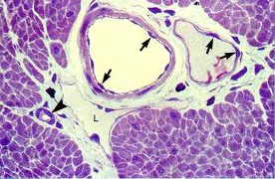
Lymphatic capillary
blood venules
endothelium
Lymphatic capillary
blood capillary

Slide 5
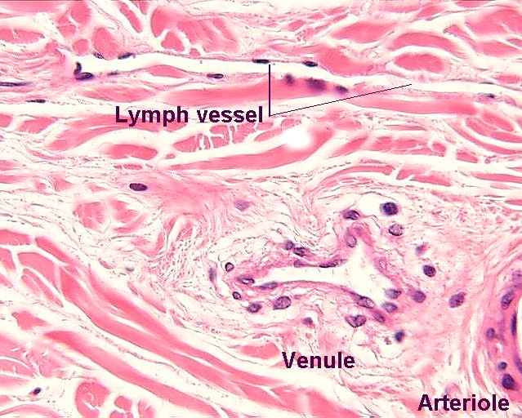

Slide 6
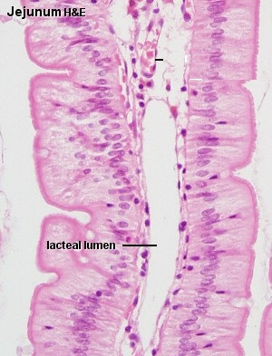
Lymphatic capillary
Striated border
Goblet cell
Intestinal villus
Simple columnar epithelium
Lacteal lumen in
Lymphatic capillary
lacteals communicate with a fine network of lymphatic vessels which ramify on the surface of the mesentery. Have valves, the absorbed oil globules, of food, slowly pass to thoracic duct

Slide 7
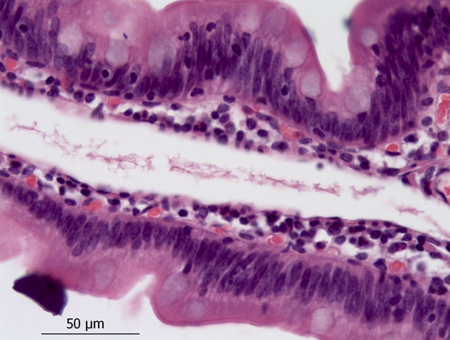
Lymphatic capillary
Lacteal lumen in
Lymphatic capillary
Simple columnar epithelium
Goblet cell
Intestinal villus

Slide 8
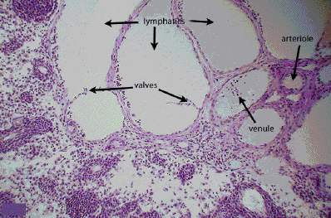

Slide 9
Larger lymphatic vessels:
The lymph passes from the capillary networks into these vessels which have slightly thicker walls & are provided with valves. They are covered with thin collagenous bundles, elastic fibers & a few smooth muscle fibers arranged tangentially or transversely to the vessel.
Vessels of greater than 0.2 mm have thicker walls, characterized with 3 indistinct layers:
Tunica intima which consists of endothelium & a thin layer of longitudinal interlacing elastic fibers.
Tunica media which have several layers of mainly circular & a few longitudinal smooth muscle fibers & several thin elastic fibers.
Tunica adventitia which is the thickest layer consists of interlacing collagenous & elastic fibers & smooth muscle fiber bundles.

Slide 10
Valves
They occur in pairs, placed on opposite sides of the vessel with their free edges pointing in the direction of the lymph flow. They are folds of tunica intima, consists of thin basal connective tissue surrounded by 2 layers of endothelium.

Slide 11
Large lymphatic vessels
Larger lymphatic vessels come together & form two main trunks:
Right lymphatic duct: it is the smallest & carries the
lymph from the upper right portion
of the body.
Thoracic duct: it carries the lymph from the other parts of
the body.
The walls of the large ducts are different from the large veins by their greater developed tunica media & less distinct division into 3 layers.

Slide 12
Tunica intima
consist of endothelial lining, several thin layers of cells & elastic fibers which are condensed near the junction site with media forming a layer similar to internal elastic lamina.
Tunica media composed of transverse smooth muscle bundles which are penetrated by elastic fibers comes from the internal lamina.
Tunica adventitia composed of longitudinal collagenous fibers, interlacing elastic fibers & a few longitudinal smooth muscle bundles. It consist of many blood vessels which may extends to the outer part of tunica media.

Slide 13
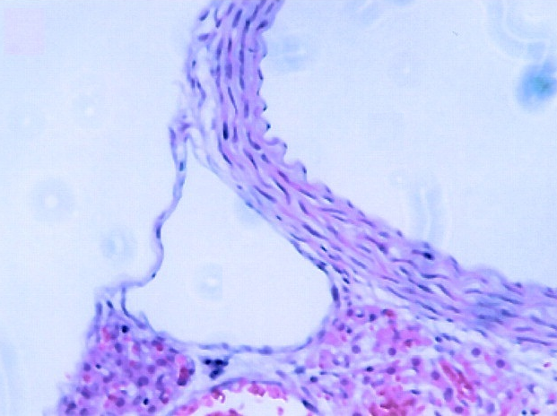
aorta
Thoracic duct
This duct passes upwards beside the vertebral column, and pours its contents into the left jugular vein in the neck

Slide 14
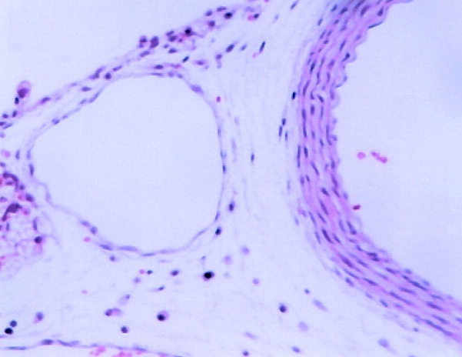
aorta
Thoracic duct

Slide 15
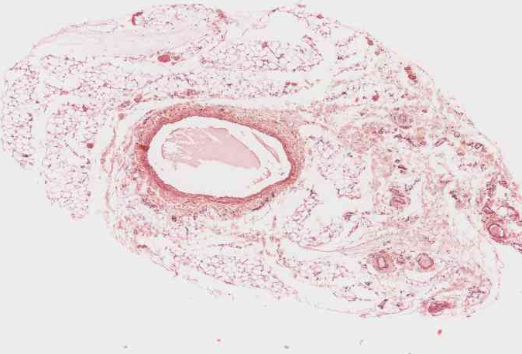
Thoracic duct

Slide 16
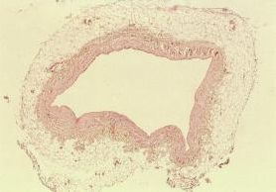
Thoracic duct
Endothelial lining (Thin layers of cells & elastic fibers)
Tunica media ( smooth muscle bundles +elastic fibers)
Tunica adventitia ( longitudinal collagen fibers + elastic fibers + longitudinal smooth muscle fibers) + blood vessels

Slide 17
Passage of lymph from the tissues into the lymphatics
Injection of certain dyes (Chinese ink) revealed that the lumen of the lymphatics does not communicate directly with the tissue spaces. The tissue fluid must pass through the endothelial cytoplasm or through narrow intercellular clefts between the endothelial cells to reach the lymphatic lumen. Inflammation can increase the permeability of the local lymphatics to certain dyes.

Slide 18
Lymphatic organs
Lymph node, spleen, thymus, tonsils & solitary lymphatic nodules.

Slide 19
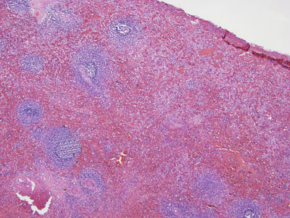
Red pulp
Spleen
Splenic nodules (white pulp)

Slide 20
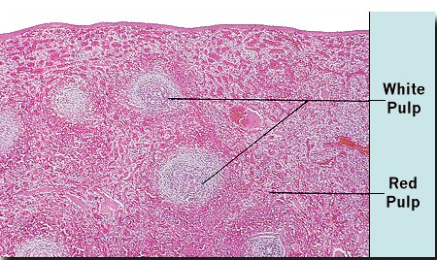
Spleen
Capsule

Slide 21
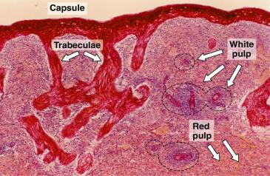

Slide 22
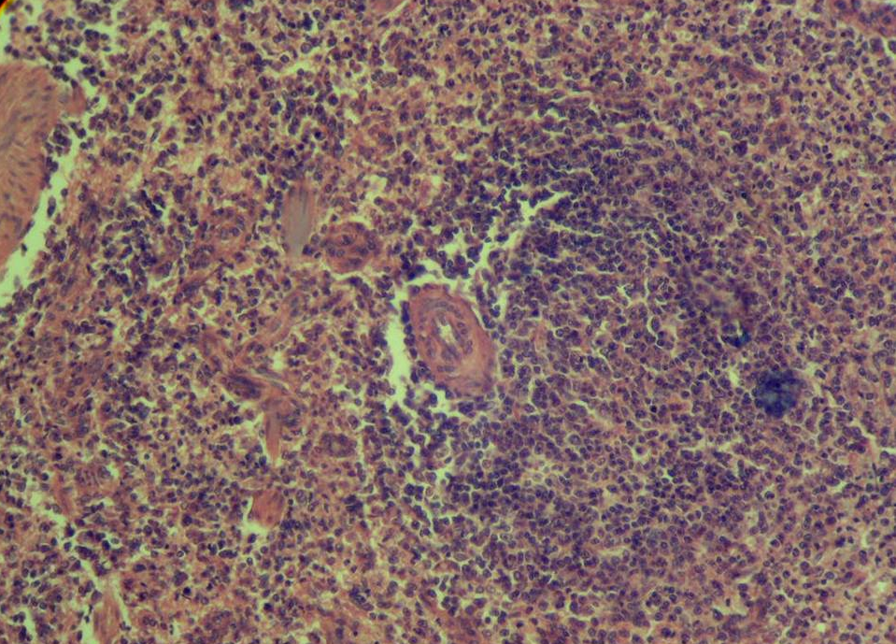
Spleen
Germinal center of the lymphatic nodule
Splenic nodules (white pulp):
Central arteriole
Red pulp:
Splenic sinuses
Splenic cords

Slide 23
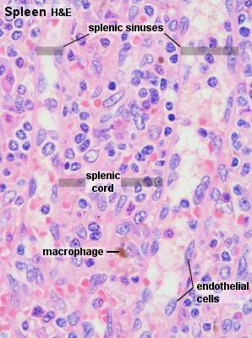

Slide 24
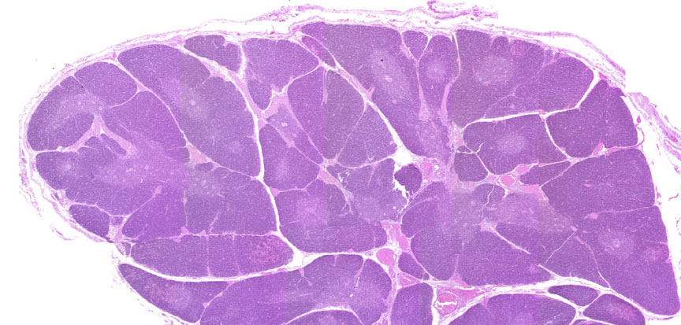
Thymus
capsule
thymus lobules
Interlobular C. T. trabeculae
thymus lobule: cortex + medulla
Blood vessels

Slide 25
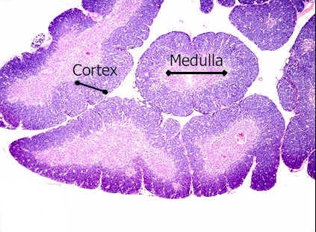
Thymus
Hassall corpuscles

Slide 26
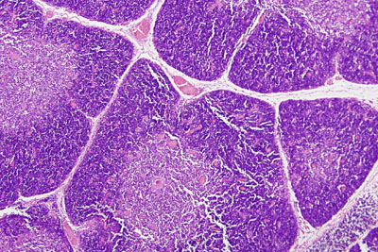
Thymus
Interlobular C. T. trabeculae
medulla
cortex
Blood vessels
Hassall corpuscles

Slide 27
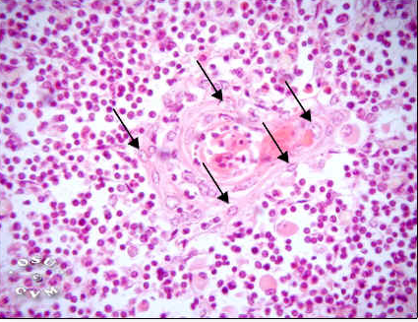
Thymus
Hassall corpuscles
Arrows showing Epithelial cells

Slide 28
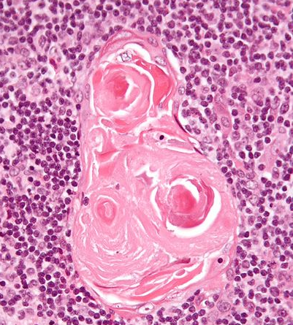
Thymus
Hassall corpuscles
Eosinophilic epithelial cells (concentrically arranged)
The surrounding medullary tissue in thymus lobule

Slide 29
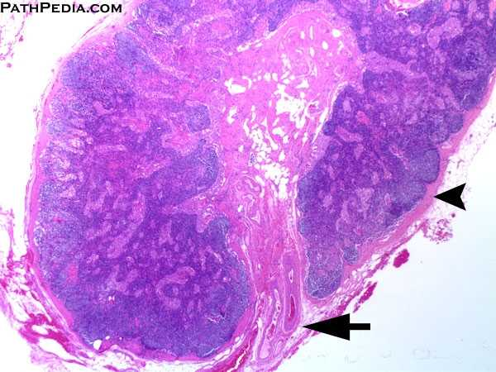
Lymph node
Cortex
Medulla
Capsule
Capsule
Trabecular C. T. + blood vessels

Slide 30
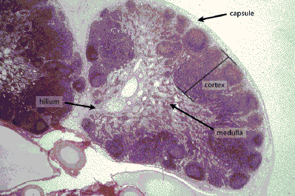
Lymph node

Slide 31
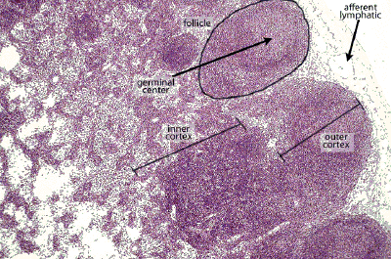
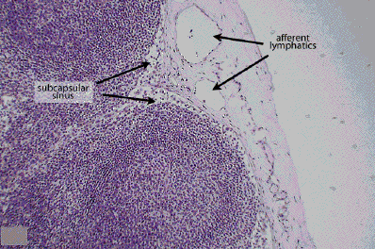
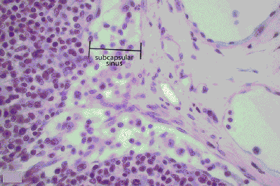
Subcapsular sinuses
Afferent lymphatics
Capsule

Slide 32
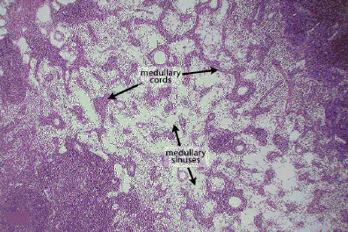
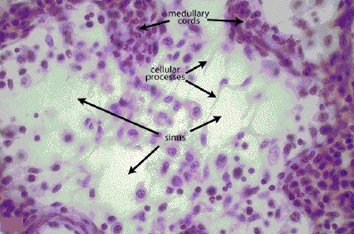
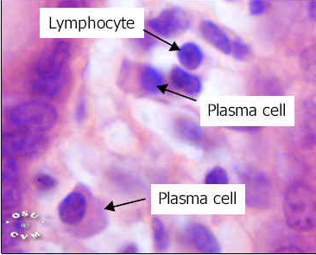
Medullary cords
Medullary sinuses

Slide 33
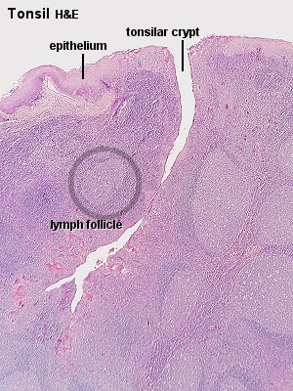
Tonsil
Stratified squamous epithelium
Lymphatic nodules: cortex & medulla
Branched crypt

Slide 34
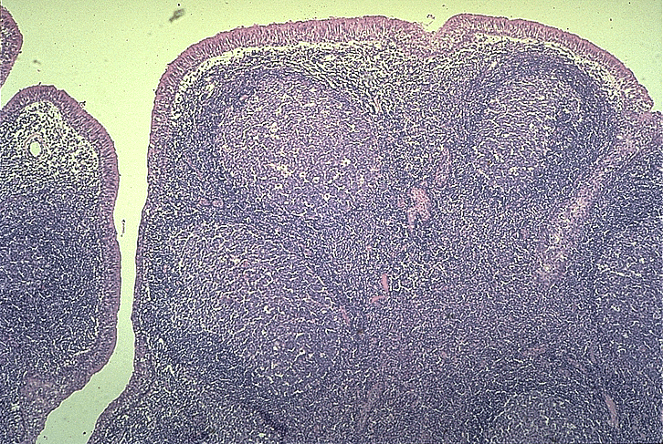
Tonsil
Stratified squamous epithelium
Lymphatic nodules:
cortex & medulla
Branched crypts

Slide 35
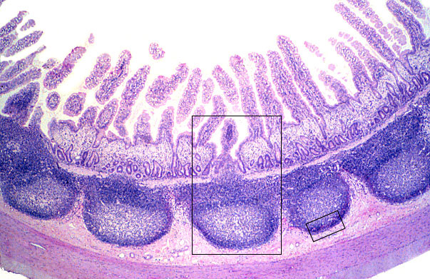
Peyer's patches: ileum
Intestinal villi
Tunica mucosa:
Simple columnar epith. with goblet cells
Tunica submucosa: contain lymphatic nodules
Tunica muscularis
Tunica serosa

Slide 36
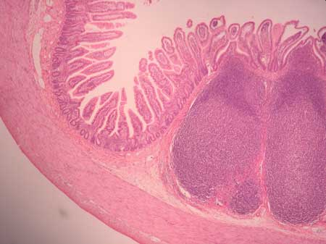
Peyer's patches: ileum
Intestinal villi
Tunica mucosa:
Simple columnar epith. with goblet cells
Tunica submucosa: contain lymphatic nodules
Tunica muscularis
Tunica serosa

